Slide 1


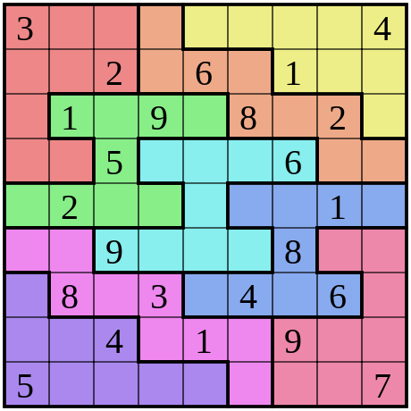


Cover Page
Sudoku
Operating systems (using concept of threads)
Submitted by:-
Anchal(102103227)
Swaroop(102103254)
THAPAR INSTITUTE OF ENGINEERING AND TECHNOLOGY, (A DEEMED TO BE UNIVERSITY), PATIALA, PUNJAB
INDIA
SUMMER 2023

Slide 2
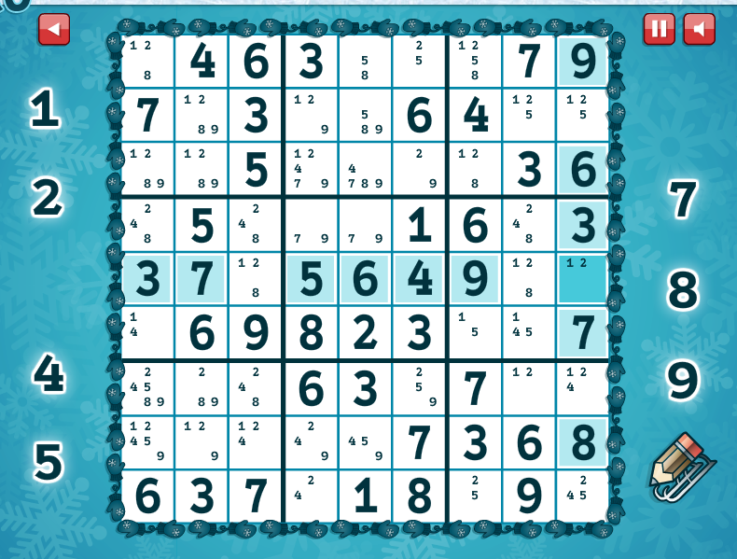
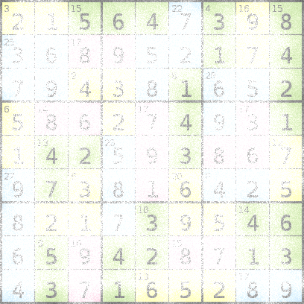
Cover page
introduction
Sudoku is a logic-based number-placement puzzle
game where the players goal is to complete a nxn
table such that each row, column and box contains
every number in the set {1, . . . , n} exactly once. In this project,
we attempted to generate a highly parallelized
Sudoku solver using the pthreads library on C plus plus compiler.
Based on our runtime evaluation, we achieved an average speedup
of 0.0099 seconds times over the serial implementation by
using locking and yielding methods with threads implementation of a highlyparallelized Sudoku Solver using the pthreads library on the C++ compiler

Slide 3



Cover page
Motivation
This project is motivated by the increase in popularity of Sudoku and similar logic puzzles over the past decade . Numerous serial Sudoku solver implementations exist and are readily available .However, due to its recency, there is relatively little work on parallel implementations. Parallelizing a serial Sudoku solver can improve its speed and increase the viability of solving larger size Sudokus. The Sudoku solver algorithm also conveys some of the basic tradeoffs of parallel software development such as dependencies and work-sharing which are interesting to inspect and study.

Slide 4

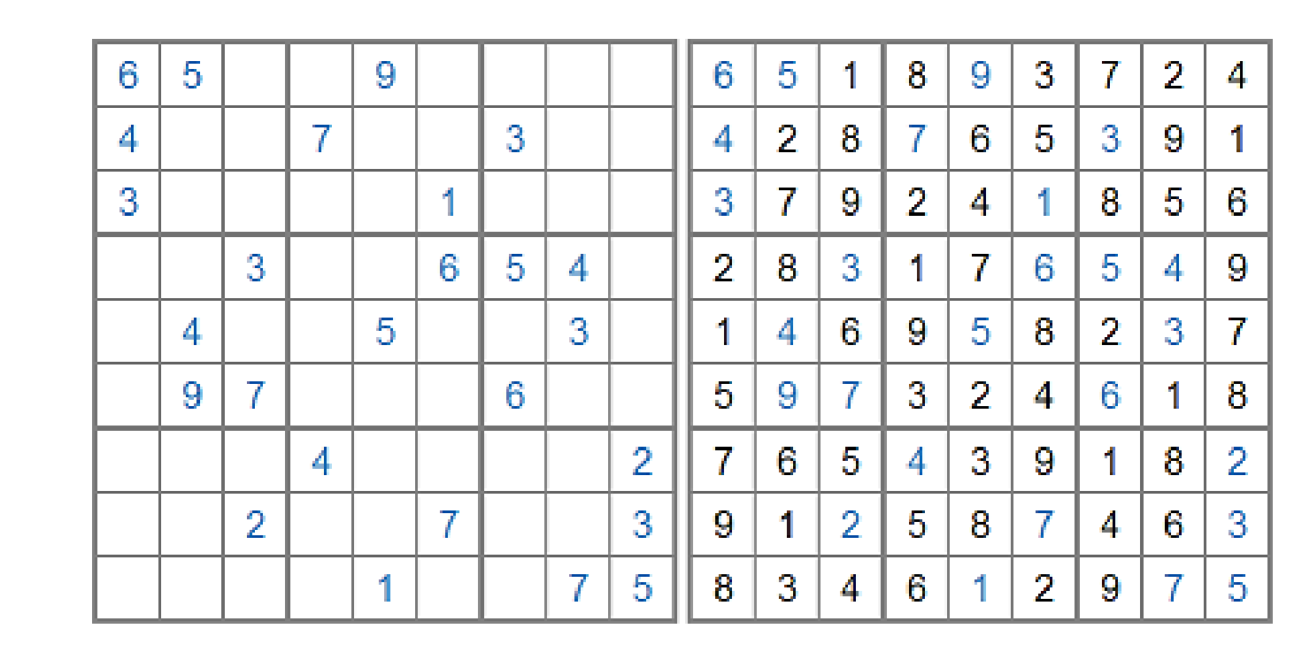
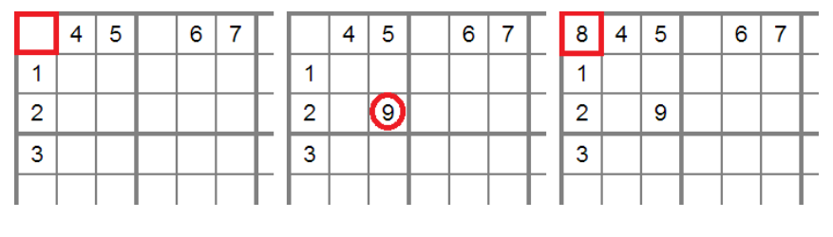
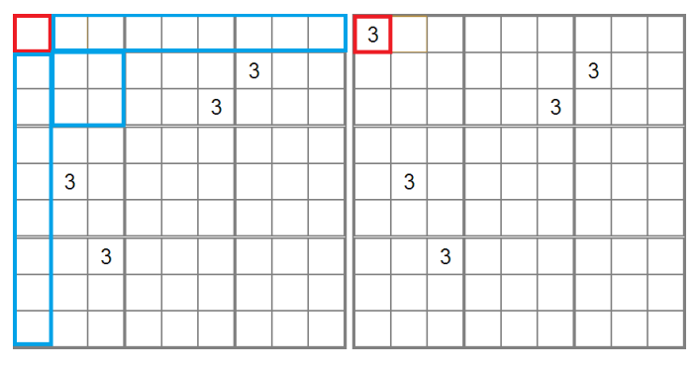
OVERVIEW OF SUDOKU
Rule 1: For any cell, if a number already exists in its row, column or box (the cell’s peers), the possibility of that number for that cell is removed.
Rule 2: For any cell, if all of its peers has a specific number removed, the cell itself must contain that number.

Slide 5
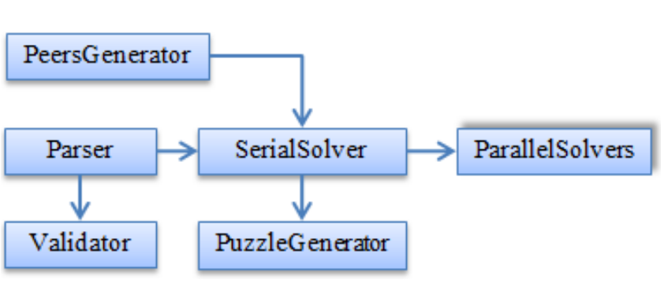
Cover Page
IMPLEMENTATIONS
DETAILS
1. Swap cells (rows) horizontally
2. Swap cells (columns) vertically
3. Swap cells around the main diagonal
4. Swap cells around the minor diagonal

Slide 6
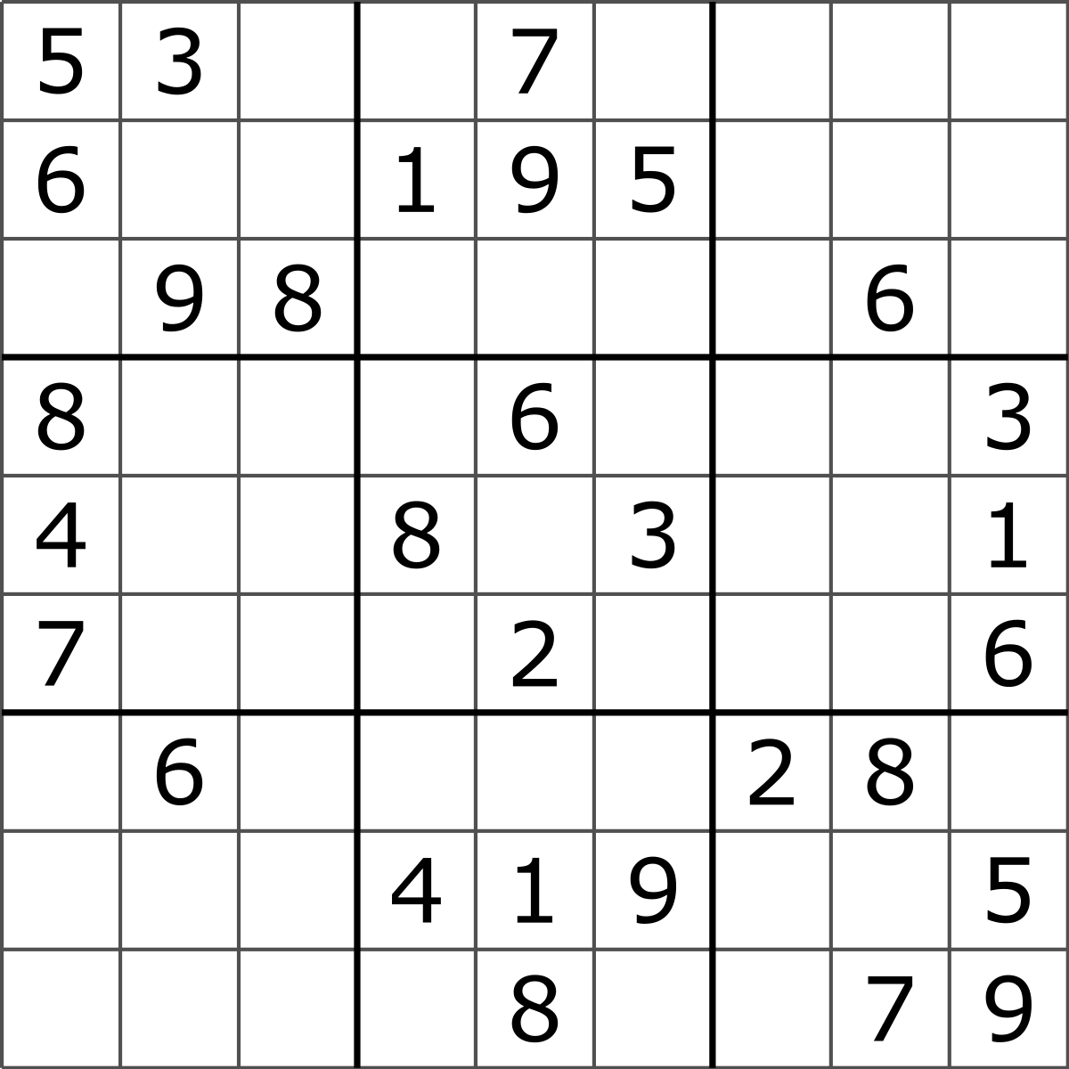
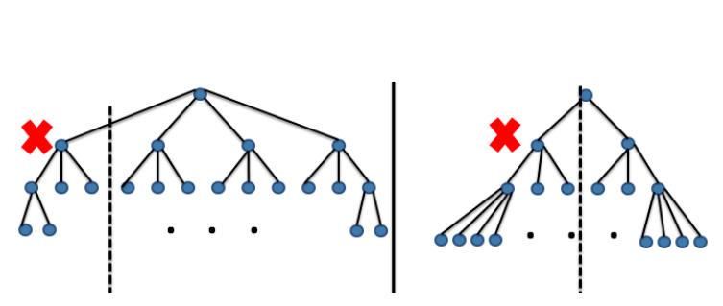
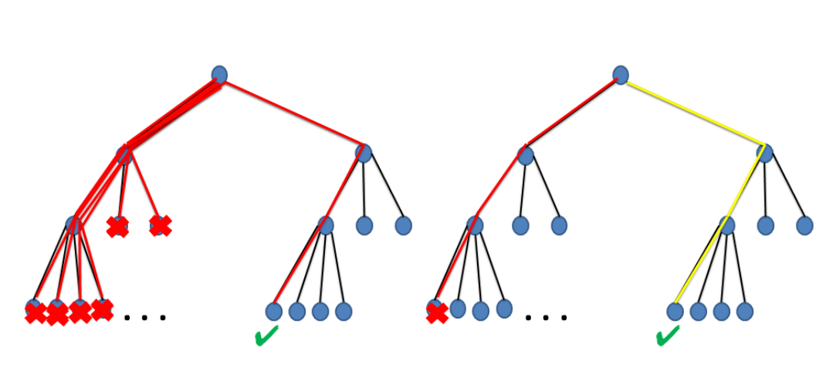
PARLLEL SOLVER

Slide 7
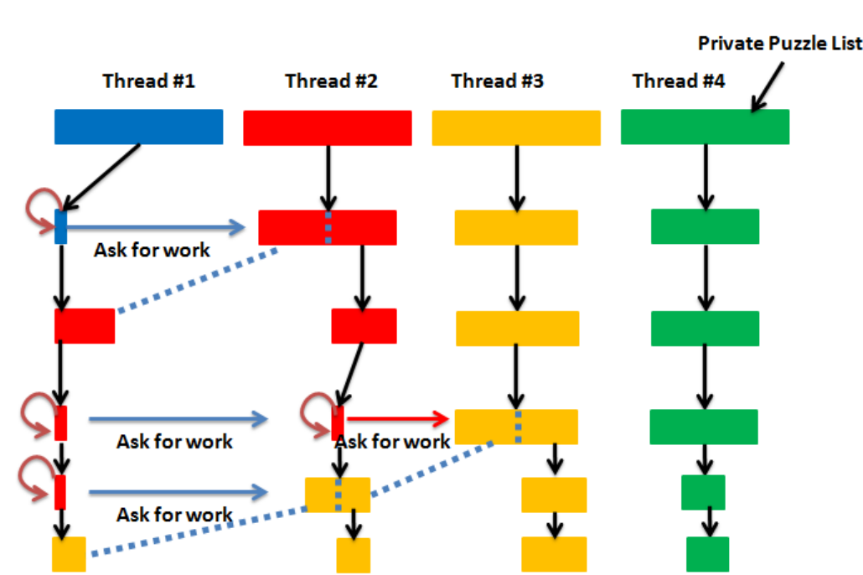
Cover page
Message passing

Slide 8
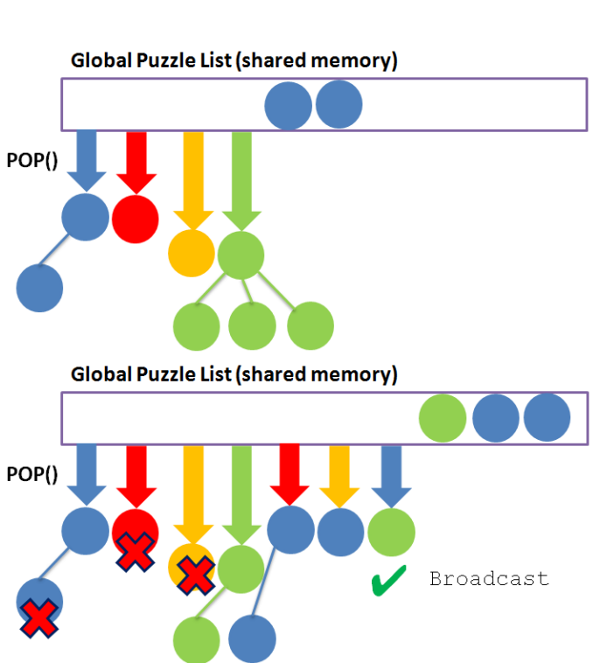
Cover page
Using locks
no thread will be idle at any time

Slide 9
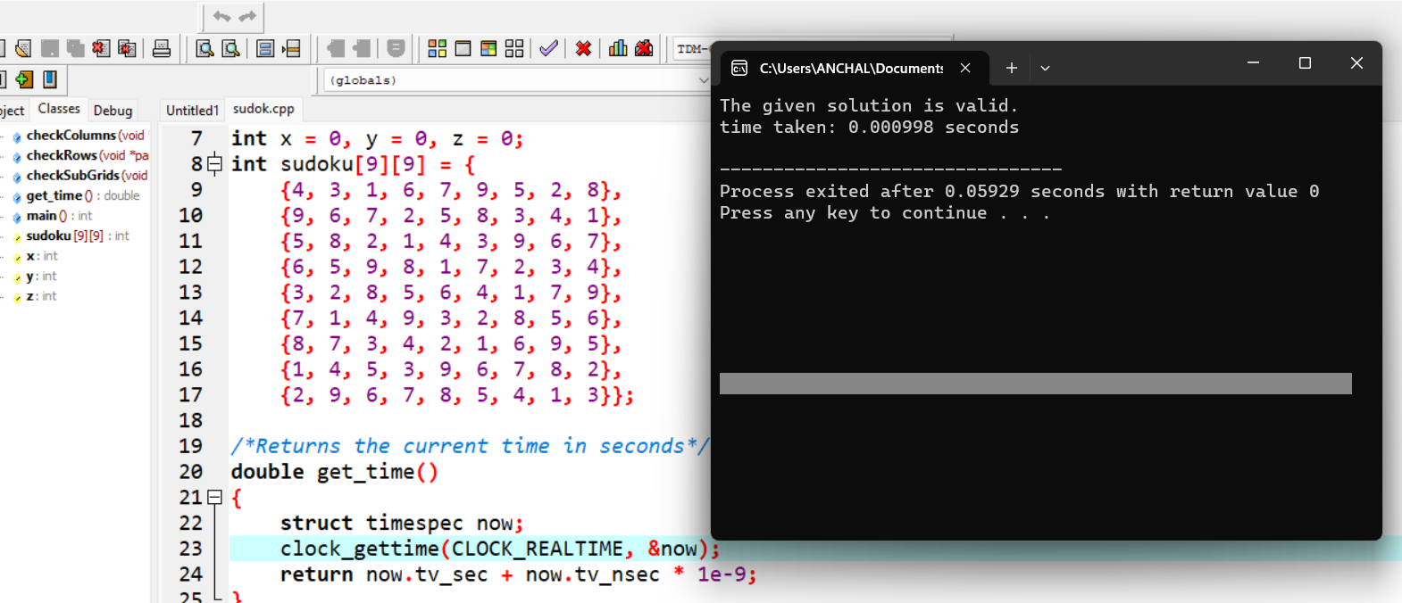
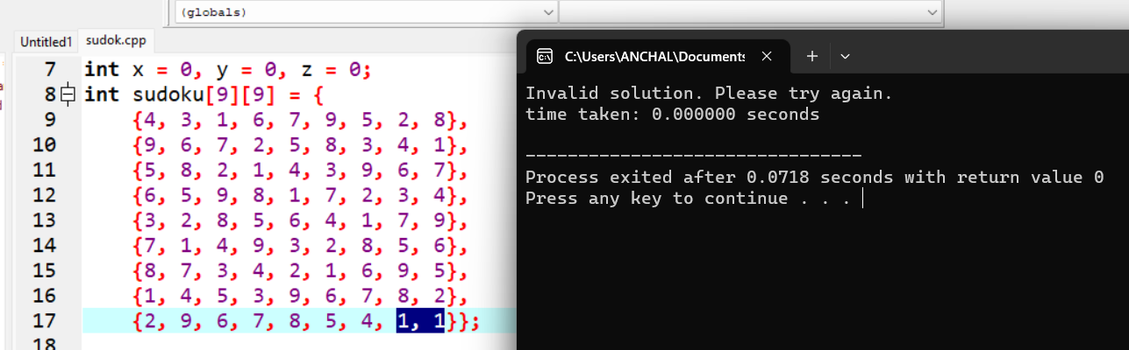
Code output

Slide 10
FUTURE WORK
**Here we provide a few possible directions in which the work presented in this PROJECT can be extended. One task we could attempt is to possibly improve our message passing algorithm so that any working thread can transfer work to any thread asking for work to prevent the cascading effects observed in our current implementation. We believe this would work better in minimizing the time a thread waits for work, with the trade off of a possible bottleneck when multiple threads attempt to give work and fight for a lock.
**Another possibility would be to see the impact of using a larger number of threads. For this to be beneficial, we may need to test on a machine that can take better advantage of a larger number of threads.

Slide 11

Cover page
CONCLUSION
This report introduces several parallel implementations of a Sudoku solver based on Constraint Propagation and Search methods. Strongly connected dependencies made it extremely difficult to parallelize CP. Traversing the solution space tree during a Search in parallel is the best way to reach a solution faster.
Using lockingcondition algorithms increased the execution time. Overheads caused by increasing the number of threads beyond four did not allow the runtime to decrease any further

Slide 12
Thank you
REFRENCES:
M. Fackler, “Inside japans puzzle palace.” [Online]. Available: http://www.nytimes.com/2007/ 03/21/business/worldbusiness/21sudoku.html? pagewanted=all& r=0
-

